Slide 1
South Dakota Association of School Business Officials (SDASBO)
September 25, 2025

Slide 2
Thank you for your work!
You make sure the bills are paid
You make sure people are protected
You ensure people have $$ to spend (Personally)
You ensure that the district has $$ to spend (Professionally)
You provide advice/support for others (Superintendent & Board)
You do it all with very little recognition or fanfare.

Slide 3
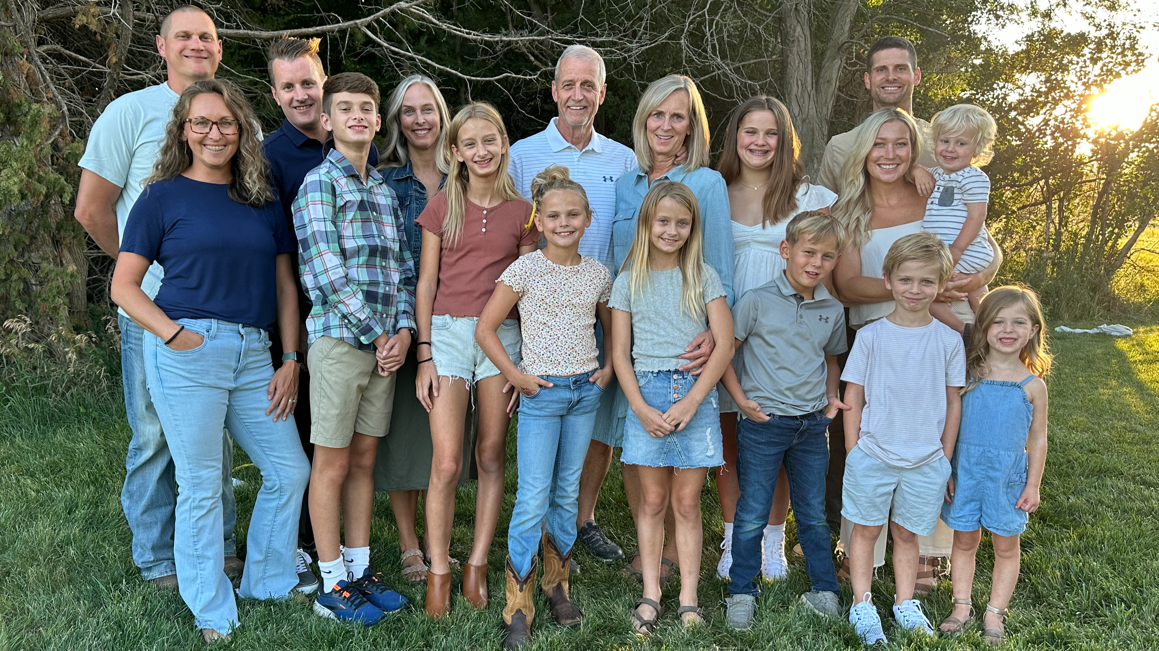

Slide 4

Thanks for sticking around!
Let’s Warm-Up!

Slide 5
Warm-up – Can you fill in the blanks?
Q - 26 = L_________________ of the A_____________________
A- 26 = Letters of the Alphabet

Slide 6
Another one…
18 = H__________ on a G_____________ C______________

Slide 7
Again…
54 = C___________ in a
D _______________

Slide 8
How about this one?
32= D_________________ at which W_______________ F____________________

Slide 9
How about a harder one?
4 = Q_____________ in a G______________ or Q_____________ in a G________________

Slide 10
Another…
200 = D _________ for P_______ G___ in M___________

Slide 11
One more?
1000 = W__________ that a P___________ is W ___________

Slide 12
Final question…
57 = H______________
V __________________

Slide 13
GOALS FOR TODAY
ME – How can I be a good team member?
WE – How can I work better with my team?
TEAM – How can my team be more effective?

Slide 14
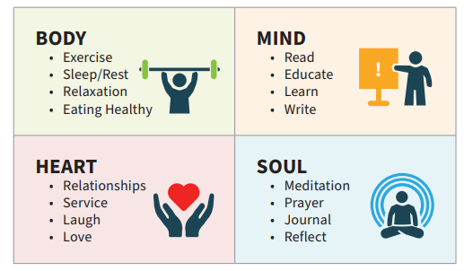
ME – BALANCE – How am I doing?

Slide 15



Do not edit
How to change the design
Rank each of the four areas from BEST (1) to WORST (4)
The Slido app must be installed on every computer you’re presenting from

Slide 16
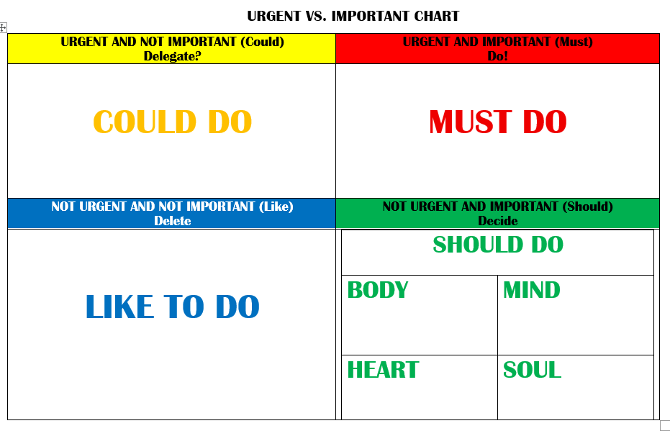
Self Care – GREEN BOX!

Slide 17
Benefits of Self-Care – Self-Care is not selfish!
You are happier when you come to work
You will have more energy to solve problems
You will have more patience with others
Reduced stress and anxiety
Increased coping skills

Slide 18
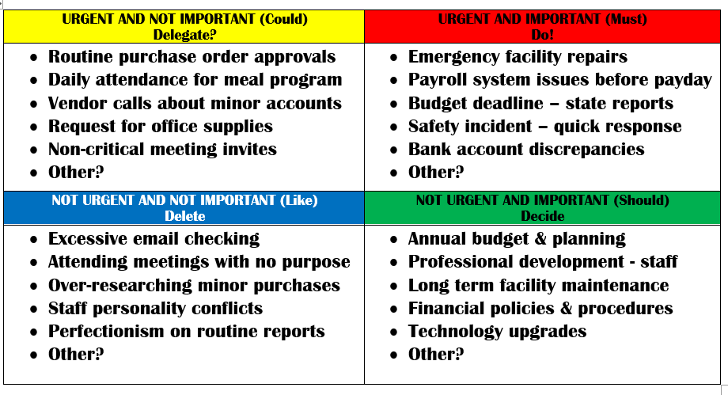

Slide 19

ME - What is your brand at work?
ARE YOU A:
ADDER? – Positive – Supportive – TEAM
SUBTRACTOR? – Negative – Critical – ME
DIVIDER? – Quietly divisive – Problem identifier - Recruiting others
MULTIPLIER? – Eager to serve – Problems & Solutions – Makes others better

Slide 20
ME - Are you an Ideal Team Player??
HUMBLE
HUNGRY
SMART
“There you are” instead of “Here I Am” (Others before self)
Think less of self – more about others.
Listens
Admits mistakes
Raises hand – pick me!
Extra mile (And then some)
Passion for the mission
Looks for opportunities to contribute
Can read the room – knows what to say and when to say it.
Awareness of others – knows about others – how they think and feel.
Articulate

Slide 21
WE – WORKING WELL WITH OTHERS
The Four Pillars of TRUST
Sincerity
Audio = Video
Clear communication.
Reliability
Follow through. Consider it done!
Competence
Admit what you know & don’t know.
Care
Genuine concern for others.

Slide 22
WE – Working with different styles
BUSINESS MANAGER | OTHERS
Analytical Thinking – Here and now (Trees) | Big Picture Focus – Down the road (Forest)
Task Focus – Results | People Focus - Harmony
Process orientation – Established procedures | Creative problem-solving - Innovation
Risk awareness – Protect the taxpayer | Risk tolerance – Give it a try
Regulatory knowledge – Laws, policies | Intuitive decision making - Feelings

Slide 23
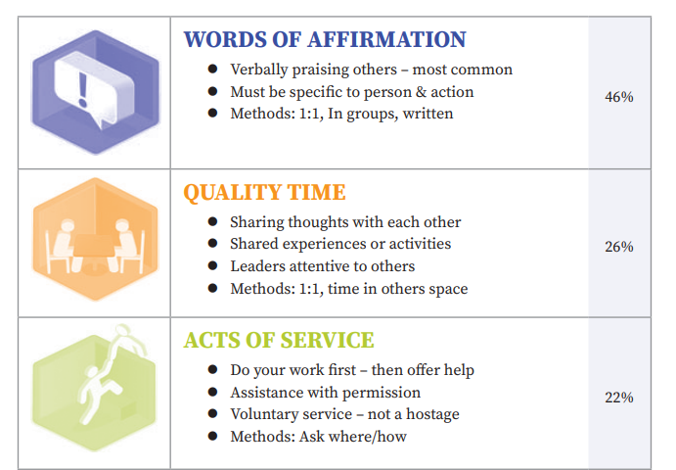
WE - Languages of Appreciation – Most common and most popular

Slide 24
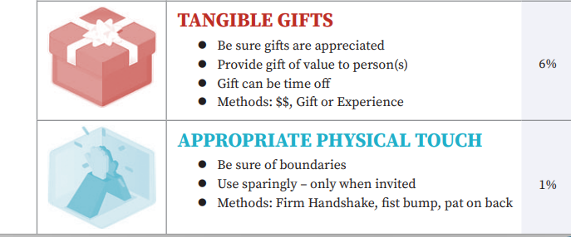
WE - Languages of Appreciation – Less common and less popular

Slide 25

Do not edit
How to change the design
How do you like to be appreciated?
The Slido app must be installed on every computer you’re presenting from

Slide 26

TEAMS – WE ARE ALL ON ONE!
.

Slide 27
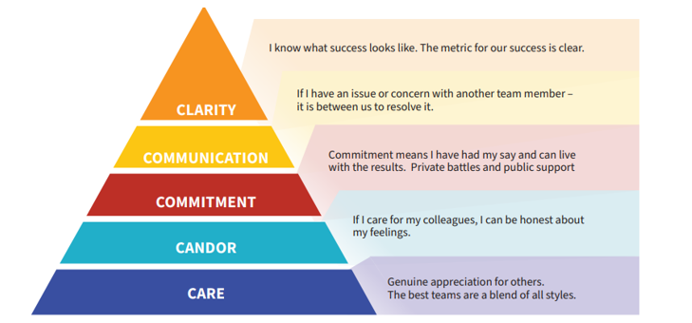
FIVE QUALITIES OF AN EFFECTIVE TEAM

Slide 28
Common myths about teams
The best teams get along perfectly.
Everyone on the team should contribute equally to every decision.
Team consensus is always the goal.
Team success means everyone feels good about every decision.
More collaboration always leads to better results.

Slide 29
Discussion Questions – THINK/PAIR/SHARE
How can you show others you CARE?
How can you have CANDOR and maintain good relations?
How can you demonstrate COMMITMENT as a team member?
How can you COMMUNICATE with others about areas of concern?
How can you help create CLARITY for district goals?

Slide 30
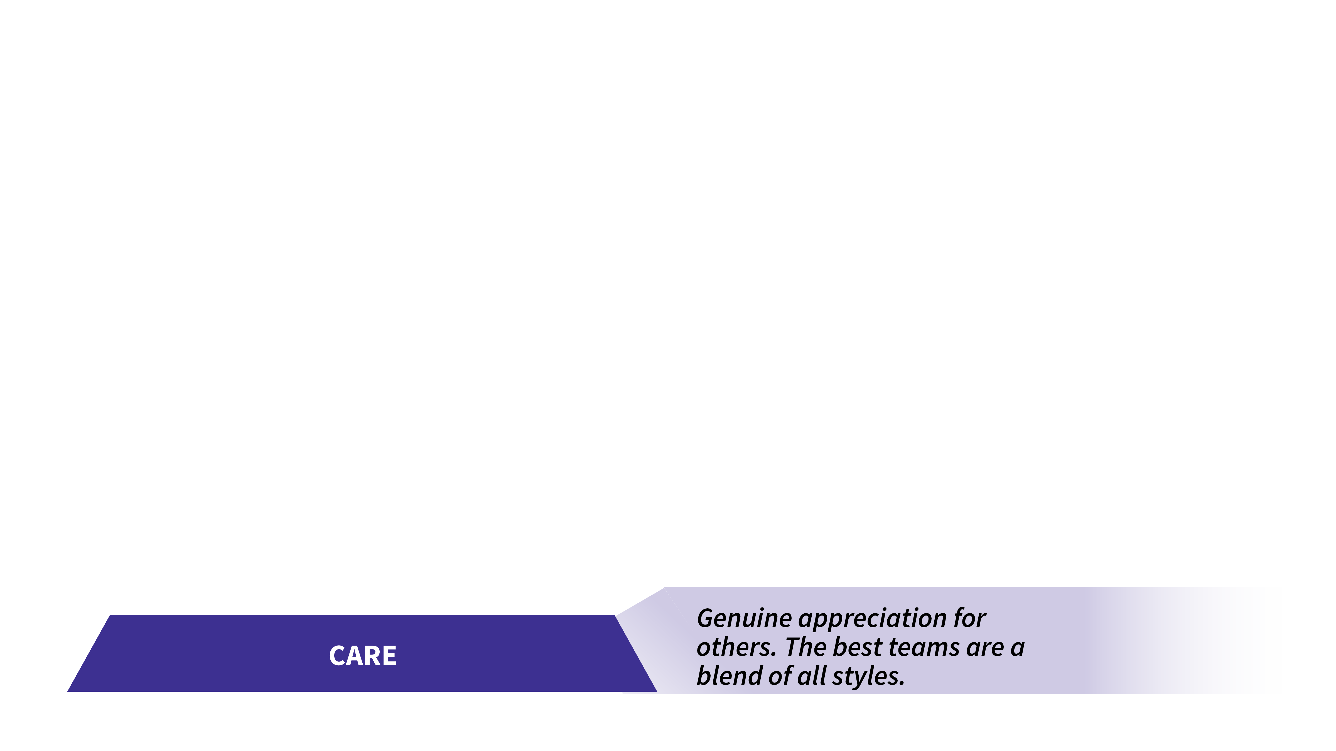
Five Qualities of a Team - CARE

Slide 31
CARE
How can you show others you CARE?

Slide 32
CARE
Words of encouragement (Genuine & Relevant)
Active listening – Eye contact – ask questions
Offer to brainstorm solutions to budget issues
Remember personal details about others
First 5 minutes of every meeting...

Slide 33
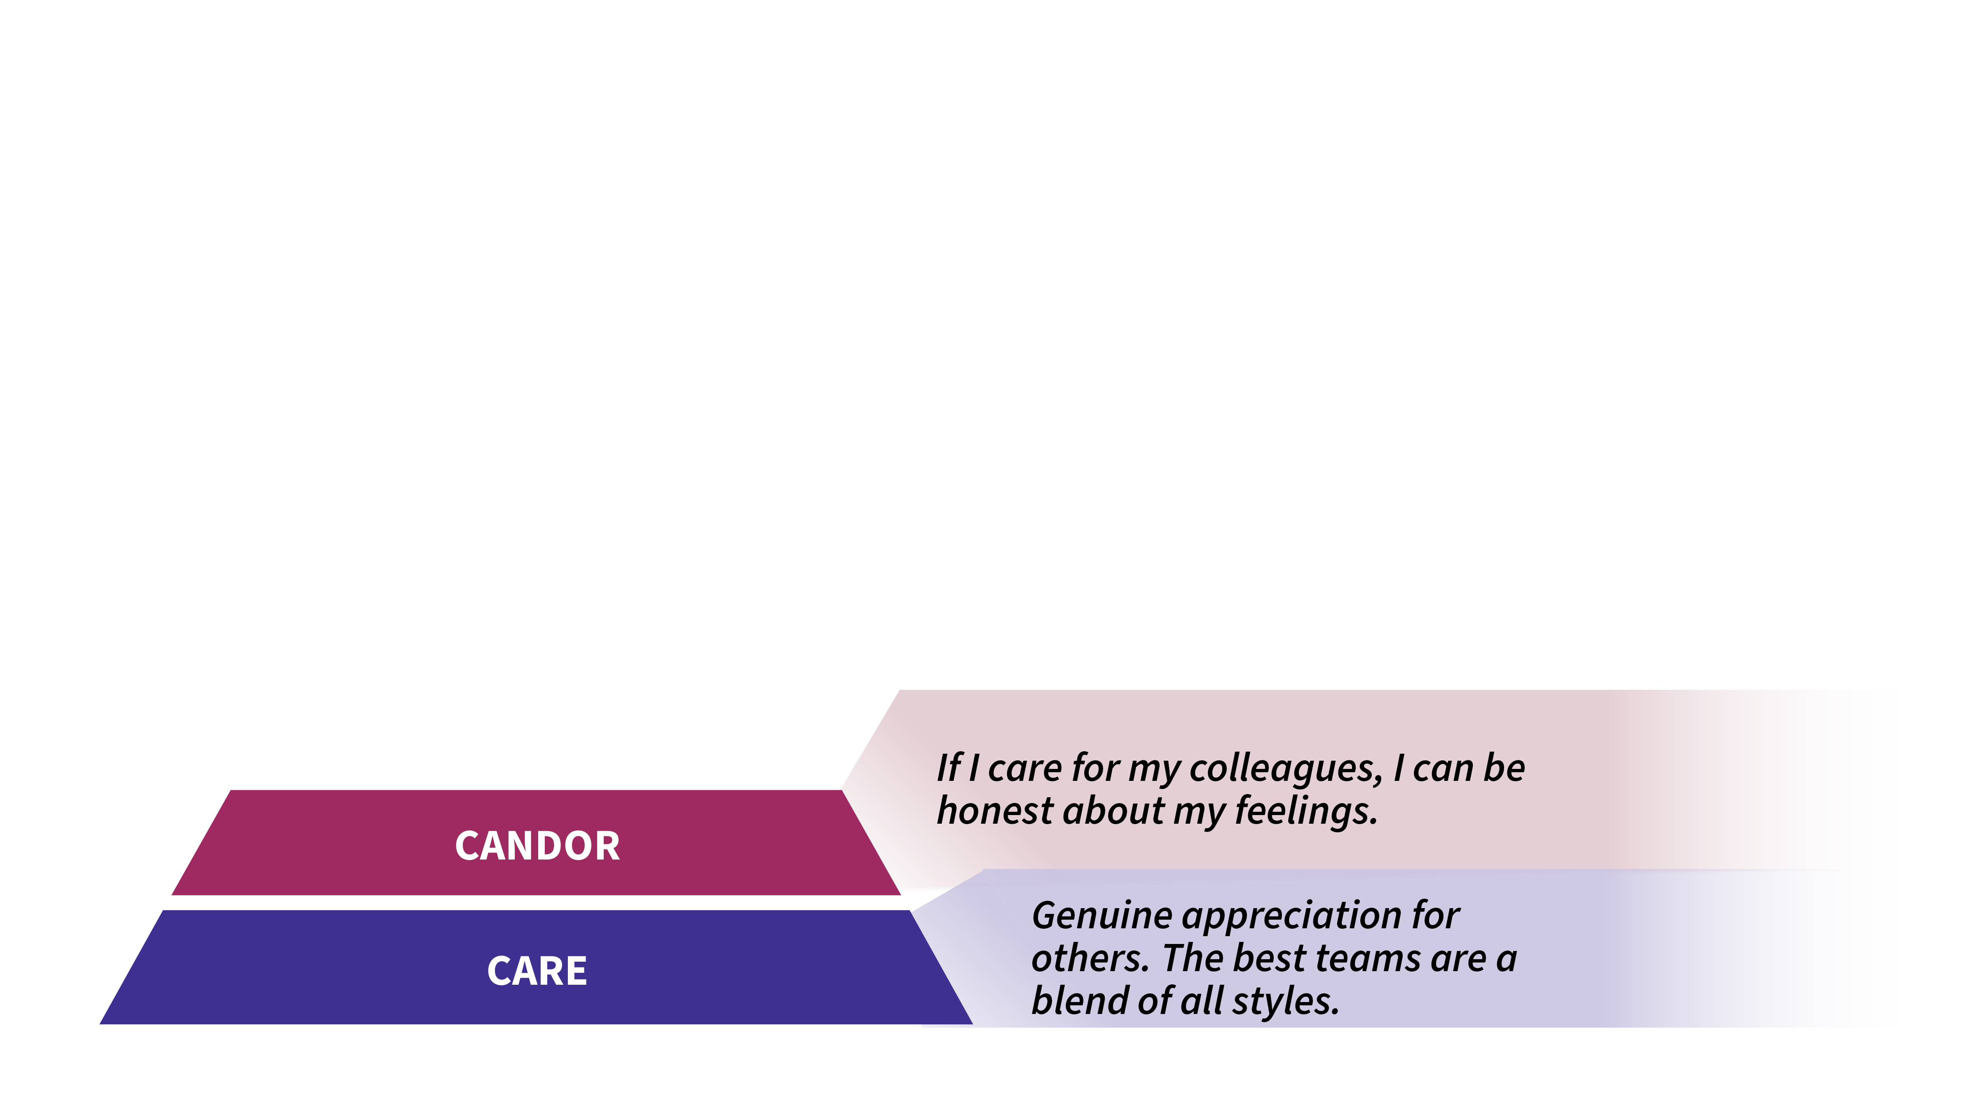
Five Qualities of a Team - CANDOR

Slide 34
CANDOR
How can you have CANDOR and maintain good relations?

Slide 35
CANDOR
Leader provides real time permission to disagree.
Use WE not YOU (We need to… vs. YOU need to…)
Present problems AND solutions
Concerns are expressed with diplomacy.
Conduct autopsies without blame.

Slide 36
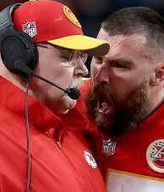
What lessons can be learned from this photo?

Slide 37
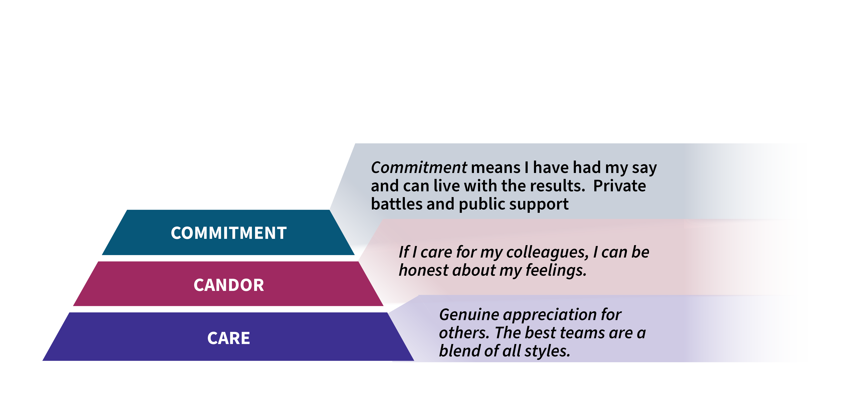
Five Qualities of a Team - COMMITMENT

Slide 38
COMMITMENT
How can you demonstrate COMMITMENT as a team member?

Slide 39
COMMITMENT
Meet your deadlines – do your part
Volunteer to help in areas outside of your office
Be open to considering new options
Follow-up and Follow-through
Make decisions – Commitment increases with action!

Slide 40
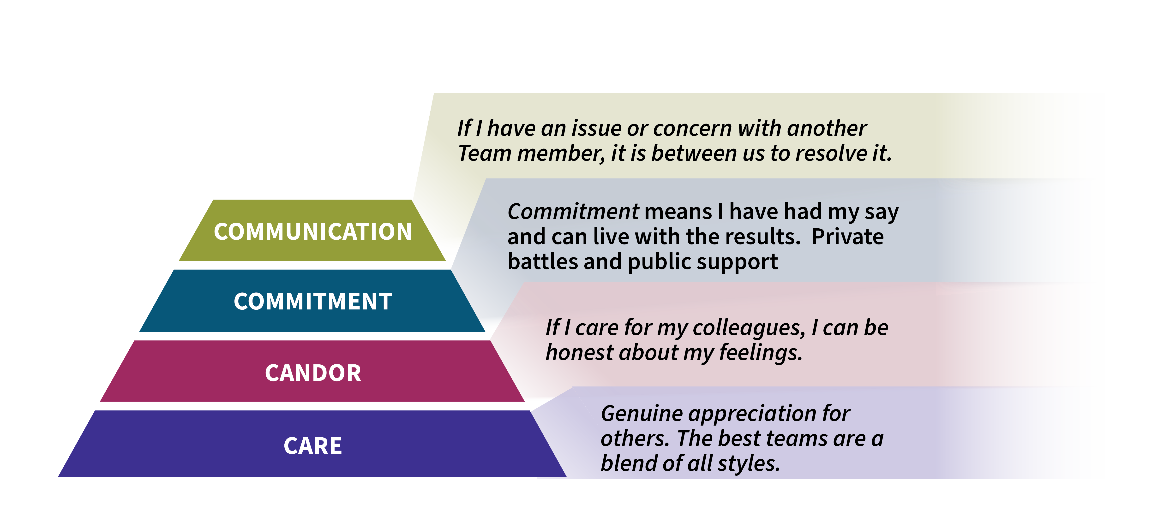
Five Qualities of a Team - COMMUNICATION

Slide 41
COMMUNICATION
How can you COMMUNICATE with others about areas of concern?

Slide 42
COMMUNICATION
Use data to frame concerns – not personal – business
Share examples and impact
Choose TIME and PLACE (timing matters)
Create regular communication channels to address issues
Responsibility without Authority – this is our organization

Slide 43
Feedback – Basic Truths
Team members who refuse to listen will eventually be surrounded by people who have nothing to say.
What we want to hear the least is what we need to hear the most.

Slide 44
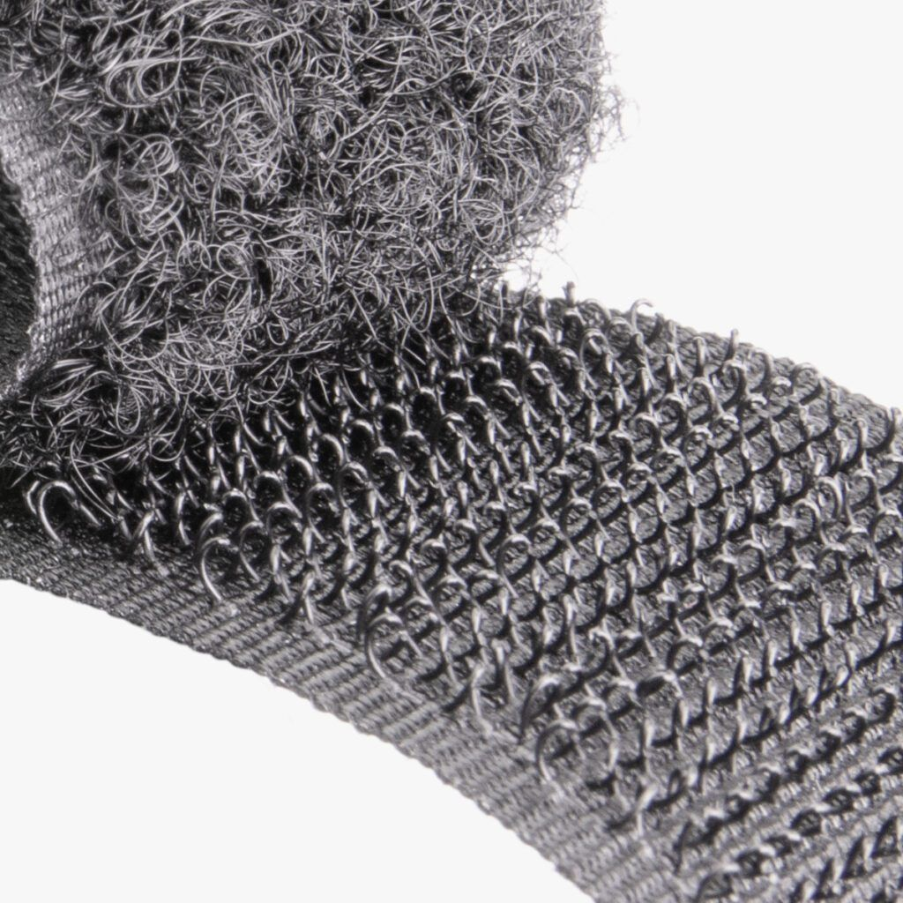
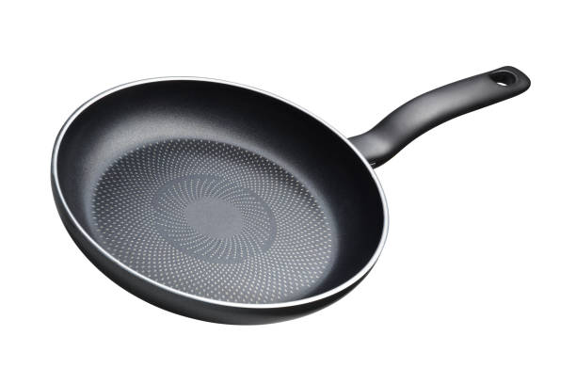
Receiving Difficult Feedback
How do you do?
Velcro – It Sticks!
Teflon – It slides off!

Slide 45
Receiving Feedback – Thoughts
Say THANK YOU!
Name ONE thing – “If you had to identify the biggest issue right now – what would it be?” “If you were me, what would you do?”
Listen for themes – People? Product? Pacing?
“The issue is rarely the issue, it is usually the state of the relationship”
Experiment:
  Try it on – “Let me think about it.”
  Try it out – “Let’s give that a try.”

Slide 46
Giving feedback - Reminders
Words matter – Bad is stronger than good
Who the Giver is matters – Boss – Spouse – Friend – Citizen
Delivery matters – Think about the receiver as you deliver
Timing matters – Sooner is better than later
Recovery time matters – Some heal faster than others
Details matter – More is better than fewer

Slide 47
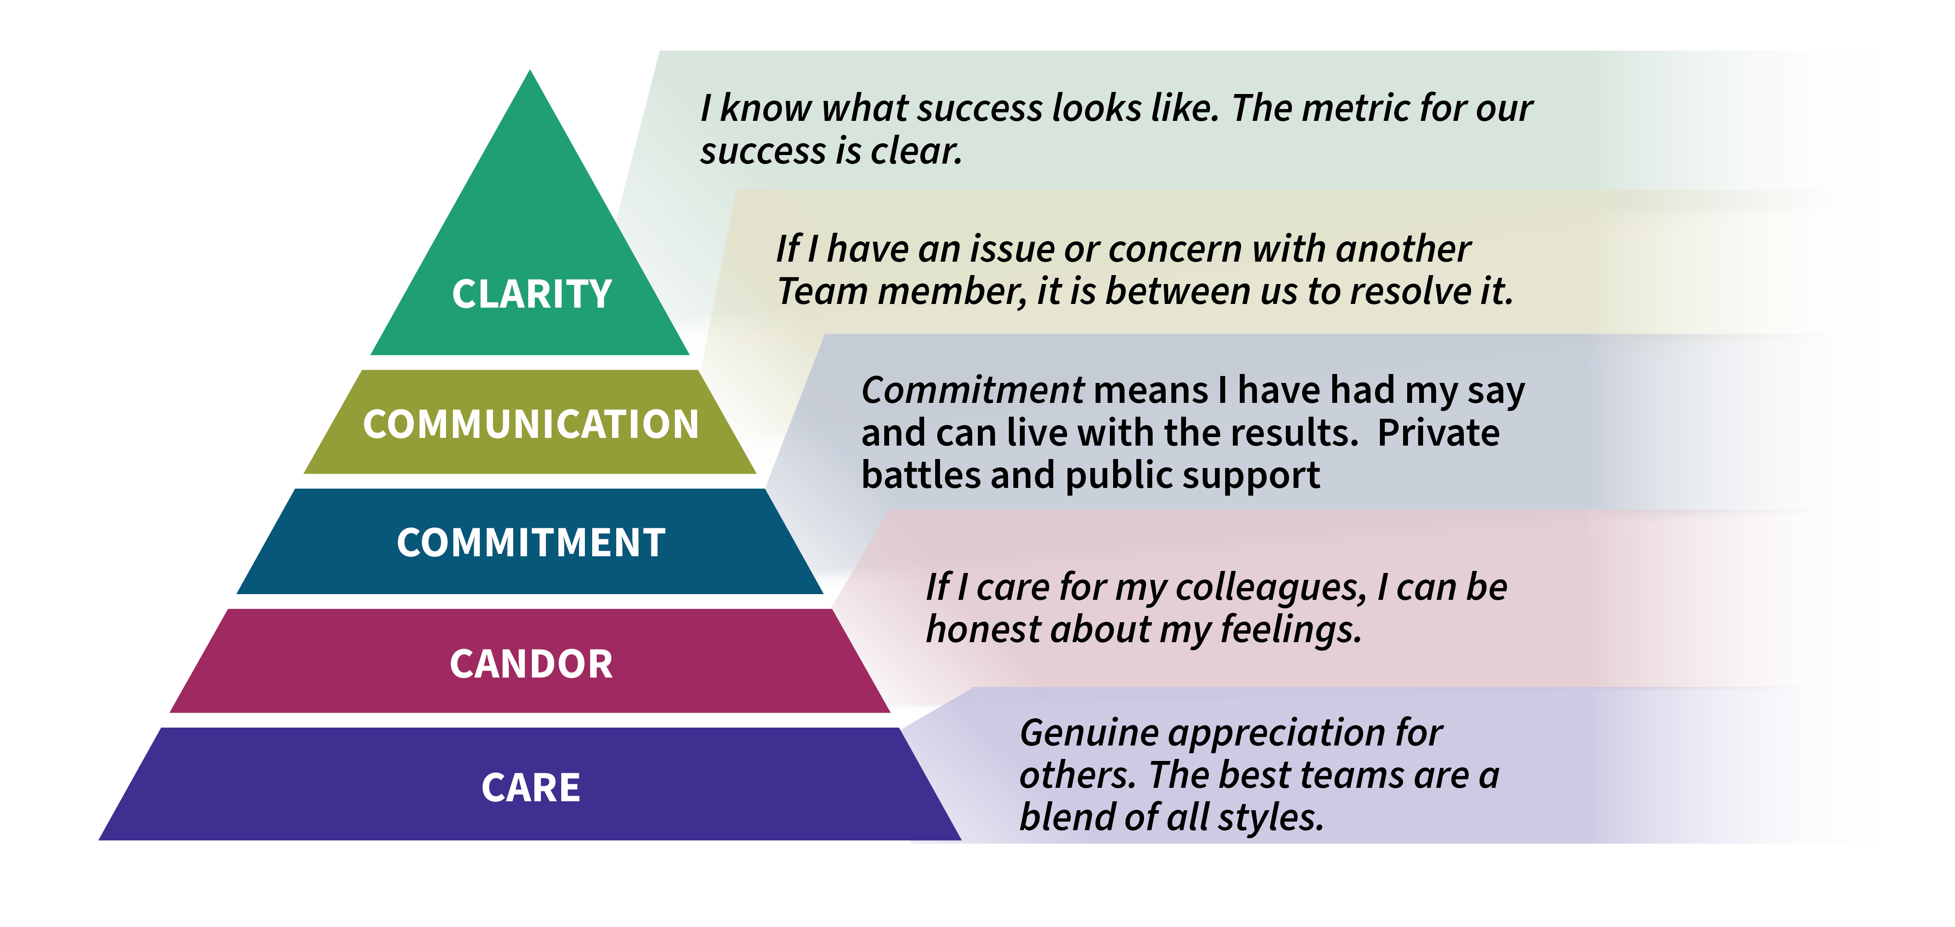
Five Qualities of a Team - CLARITY

Slide 48
What does success look like?
Test scores are strong
Budget is balanced (even a surplus!)
The sports teams are winning
The phone is not ringing
The teachers are happy

Slide 49
CLARITY
How can you help create CLARITY for district goals?

Slide 50
CLARITY
Translate big-picture (telescope) to action steps (microscope).
Discuss metrics in your meetings
Create visuals that note progress on goals
Be transparent and vocal about your goals.

Slide 51
Five Qualities of a Team

Slide 52
Do not edit
How to change the design
Which area would be a strength of your team?
The Slido app must be installed on every computer you’re presenting from

Slide 53
Do not edit
How to change the design
What area is a growth area for your team?
The Slido app must be installed on every computer you’re presenting from

Slide 54
Working with Younger Colleagues
Be ready to answer the question WHY? (Not disrespectful – curious)
Manage expectations – may expect more in less time
More immediate rewards/feedback. (Two-way - Just in time)
Focus on networking and teamwork. (Group work)
Create opportunities to experience new projects. (Variety)

Slide 55
Four Commitments (Direct Reports – Colleagues – Family)
I will believe the best about you.
If others do not believe the best about you – I will defend you.
If you do something that could erode my trust in you, I will speak to you directly about it. (Talk to you – not about you)
If I do something that erodes your trust in me, I will own it and speak to you about it.

Slide 56
NEXT STEPS
As a result of today’s session, I will…

Slide 57
Thank you!
Rick Melmer
rvmelmer@gmail.com

